Slide 1

DATABASE SECURITY
ĐẠI HỌC QUỐC GIA TP.HCM
TRƯỜNG ĐẠI HỌC CÔNG NGHỆ THÔNG TIN
KHOA MẠNG MÁY TÍNH VÀ TRUYỀN THÔNG
Thành phố Hồ Chí Minh , 2023

Slide 2
MEMBERS OF GROUP 2
20521793 - Nguyễn Trần Anh Quân
20520373 - Nguyễn Trần Đức An
20520587 Nguyễn Minh Khoa
20521741 - Trương Tuấn Phi

Slide 3
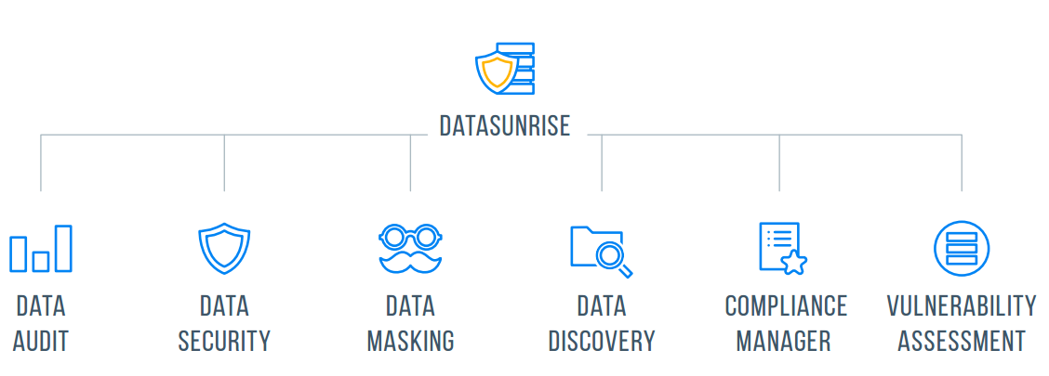
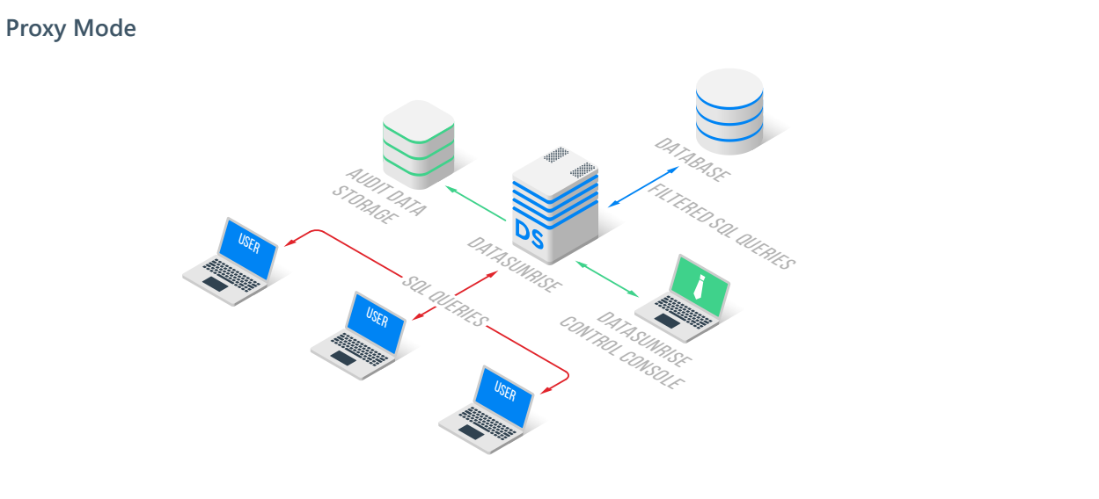
A. DataSunrise model
DataSunrise Database Security is a data-centric security solution purpose-built for the protection of relational and database contents against external and internal threats.
Alias | Address | OS
Attacker/User | 192.168.111.135 | Kali
DataSunrise | 192.168.111.139 | Ubuntu
Database Server | 192.168.111.140 | CentOS

Slide 4
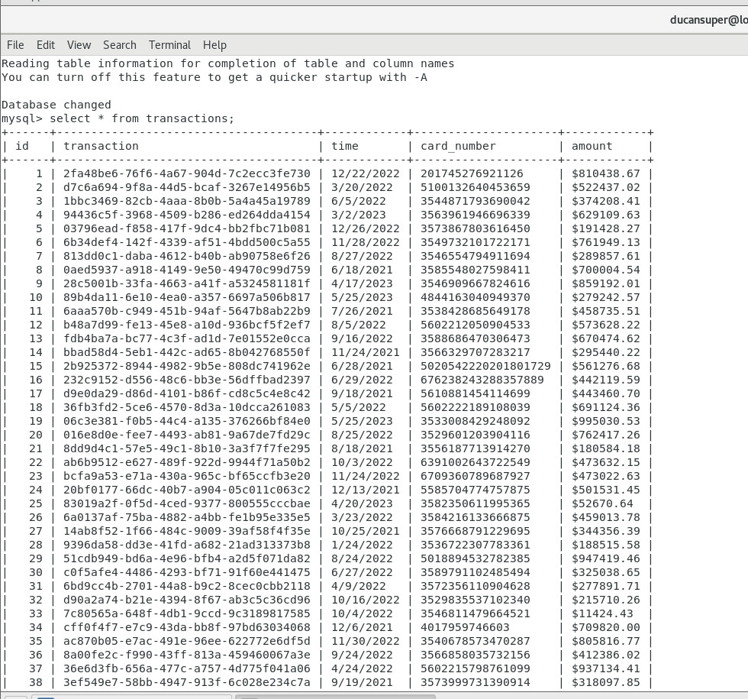
B. Database
2
1

Slide 5
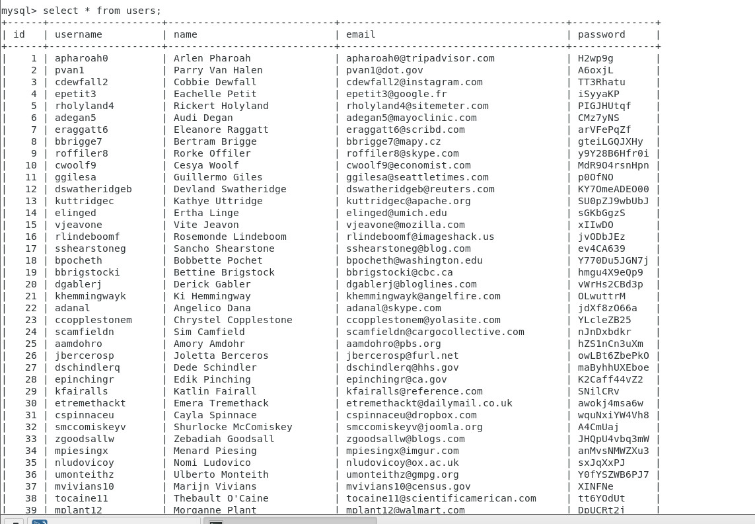
B. Database
3
2

Slide 6
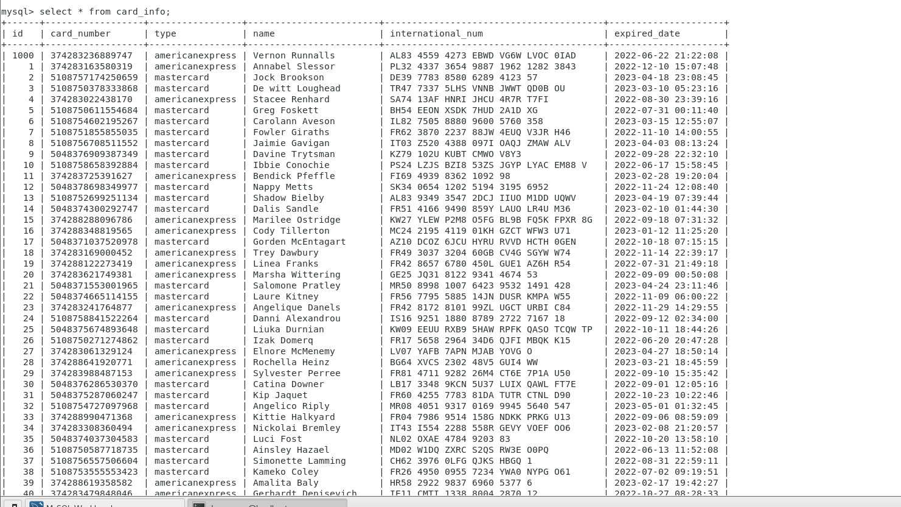
B. Database
3

Slide 7
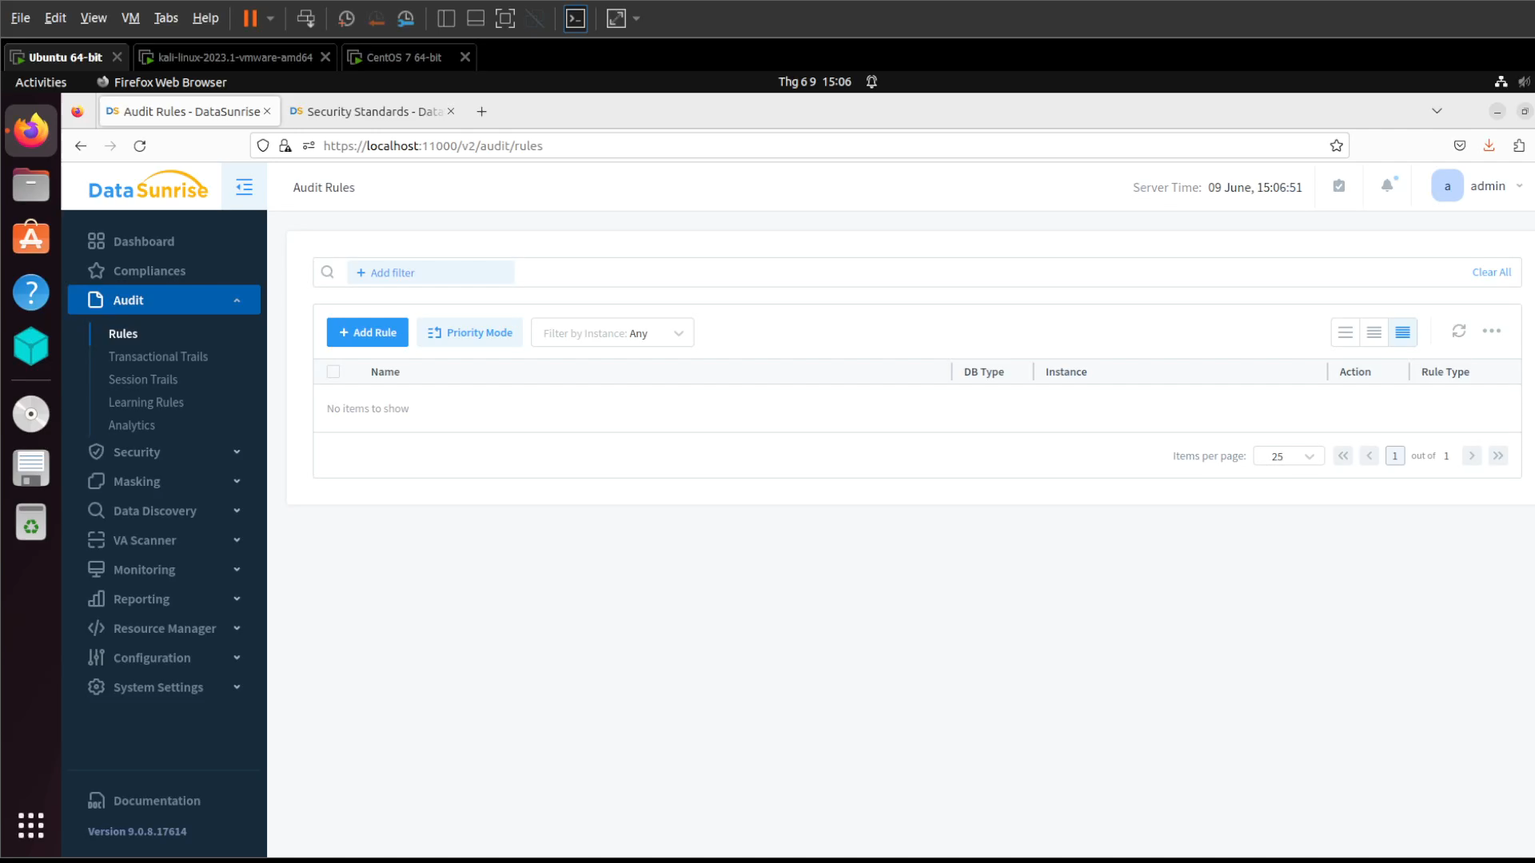
C. Active Mornitoring
Data Audit: enables real-time database activity monitoring
Database Audit logs all incoming user queries and query results and collects extensive information on all database users trying to access the protected database
It logs the query’s code, user information (IP address, username, client application name, etc.), session information, etc
Can be paired with a SIEM system to analyze the audit results

Slide 8
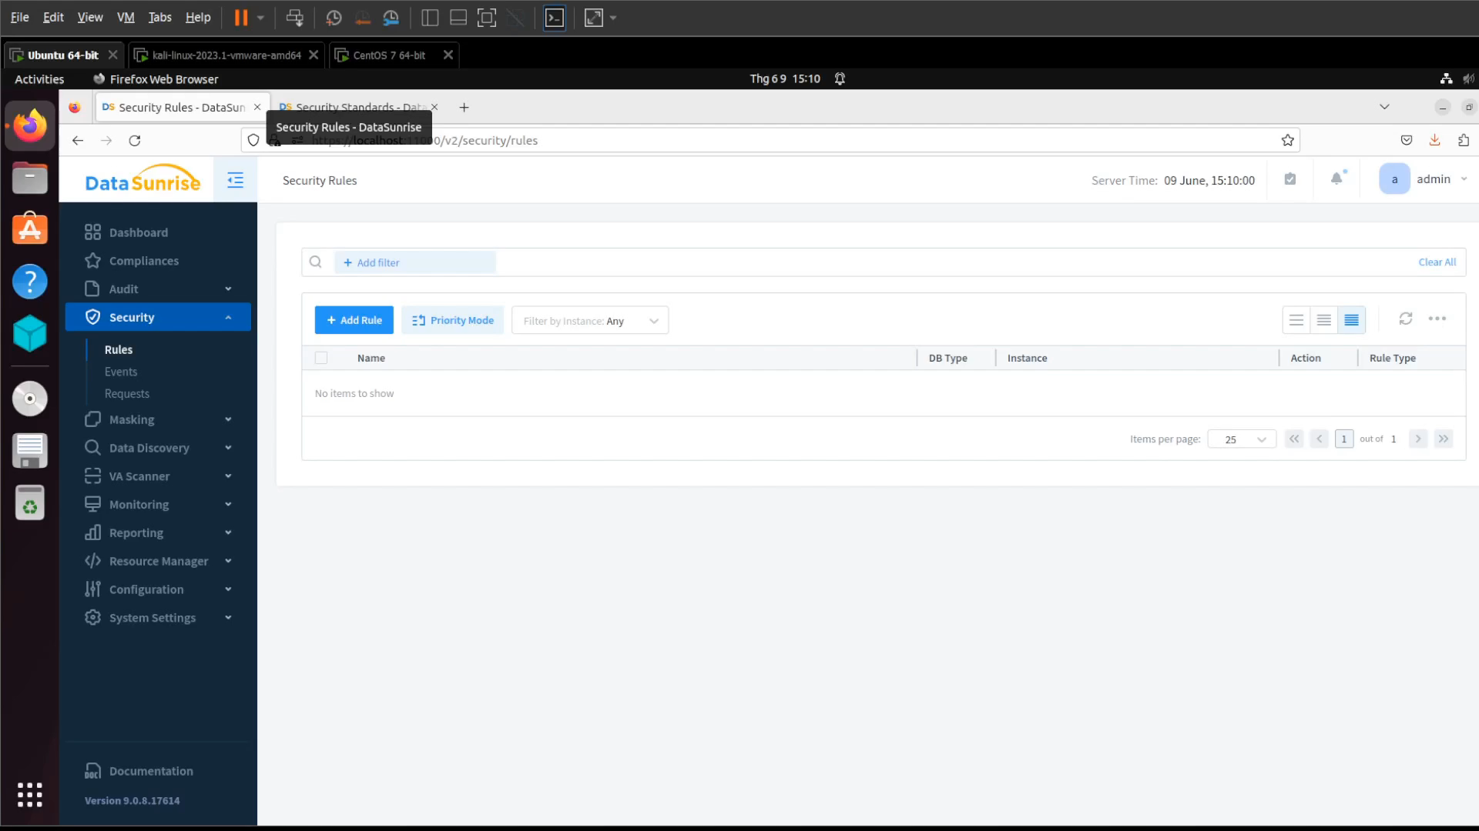
D. Database Firewall

Slide 9

D. Database Firewall

Slide 10

E. Data Masking
Data Masking capability enables DataSunrise to limit exposure of sensitive database contents to unauthorized users by obfuscating the query results
DataSunrise intercepts unauthorized user queries, modifies them according to existing masking policies, and redirects to the database

Slide 11
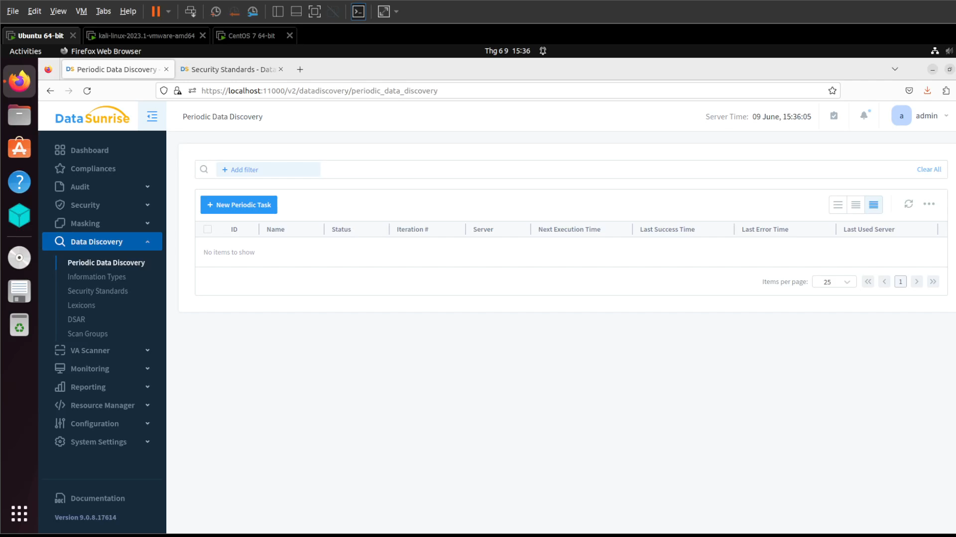
F. Data Discovery
Data Discovery enables companies to detect where sensitive and confidential data resides across their databases

Slide 12
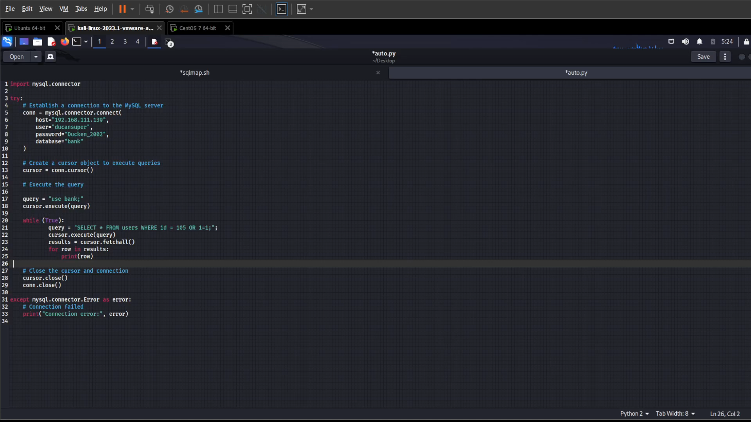
G. Performance

Slide 13
THANK YOU FOR LISTENING
🙂
ANY QUESTIONS ???

